Slide 1
The Day God Left
Ezekiel 9, 10

Slide 2
Ezekiel 9:1
¹ Then I heard him call out in a loud voice, “Bring the guards of the city here, each with a weapon in his hand.”

Slide 3
Ezekiel 9:2
² And I saw six men coming from the direction of the upper gate, which faces north, each with a deadly weapon in his hand. With them was a man clothed in linen who had a writing kit at his side. They came in and stood beside the bronze altar.

Slide 4
Ezekiel 9:3
³ Now the glory of the God of Israel went up from above the cherubim, where it had been, and moved to the threshold of the temple. Then the LORD called to the man clothed in linen who had the writing kit at his side

Slide 5
Ezekiel 9:4
⁴ and said to him, “Go throughout the city of Jerusalem and put a mark on the foreheads of those who grieve and lament over all the detestable things that are done in it.”

Slide 6
Ezekiel 9:5
⁵ As I listened, he said to the others, “Follow him through the city and kill, without showing pity or compassion.

Slide 7
Ezekiel 9:6
⁶ Slaughter old men, young men and maidens, women and children, but do not touch anyone who has the mark. Begin at my sanctuary.” So they began with the elders who were in front of the temple.

Slide 8
Ezekiel 9:7
⁷ Then he said to them, “Defile the temple and fill the courts with the slain. Go!” So they went out and began killing throughout the city.

Slide 9
Ezekiel 9:8
⁸ While they were killing and I was left alone, I fell facedown, crying out, “Ah, Sovereign LORD! Are you going to destroy the entire remnant of Israel in this outpouring of your wrath on Jerusalem?”

Slide 10
Ezekiel 9:9
⁹ He answered me, “The sin of the house of Israel and Judah is exceedingly great; the land is full of bloodshed and the city is full of injustice. They say, ‘The LORD has forsaken the land; the LORD does not see.’

Slide 11
Ezekiel 9:10-11
¹⁰ So I will not look on them with pity or spare them, but I will bring down on their own heads what they have done.” ¹¹ Then the man in linen with the writing kit at his side brought back word, saying, “I have done as you commanded.”

Slide 12
The Day God Left
Ezekiel 9, 10

Slide 13
Revelation 3:12
¹² Him who overcomes I will make a pillar in the temple of my God. Never again will he leave it. I will write on him the name of my God and the name of the city of my God, the new Jerusalem, which is coming down out of heaven from my God; and I will also write on him my new name.

Slide 14
Revelation 7:3
³ “Do not harm the land or the sea or the trees until we put a seal on the foreheads of the servants of our God.”

Slide 15
Revelation 9:4
⁴ They were told not to harm the grass of the earth or any plant or tree, but only those people who did not have the seal of God on their foreheads.

Slide 16
Revelation 14:1
¹ Then I looked, and there before me was the Lamb, standing on Mount Zion, and with him 144,000 who had his name and his Father’s name written on their foreheads.

Slide 17
The Day God Left
Ezekiel 9, 10

Slide 18
2 Timothy 2:19
¹⁹ Nevertheless, God’s solid foundation stands firm, sealed with this inscription: “The Lord knows those who are his,” and, “Everyone who confesses the name of the Lord must turn away from wickedness.”

Slide 19
2 Timothy 2:11-13
¹¹ Here is a trustworthy saying: If we died with him, we will also live with him; ¹² if we endure, we will also reign with him. If we disown him, he will also disown us; ¹³ if we are faithless, he will remain faithful, for he cannot disown himself.

Slide 20
Ezekiel 9:11
¹¹ Then the man in linen with the writing kit at his side brought back word, saying, “I have done as you commanded.”

Slide 21
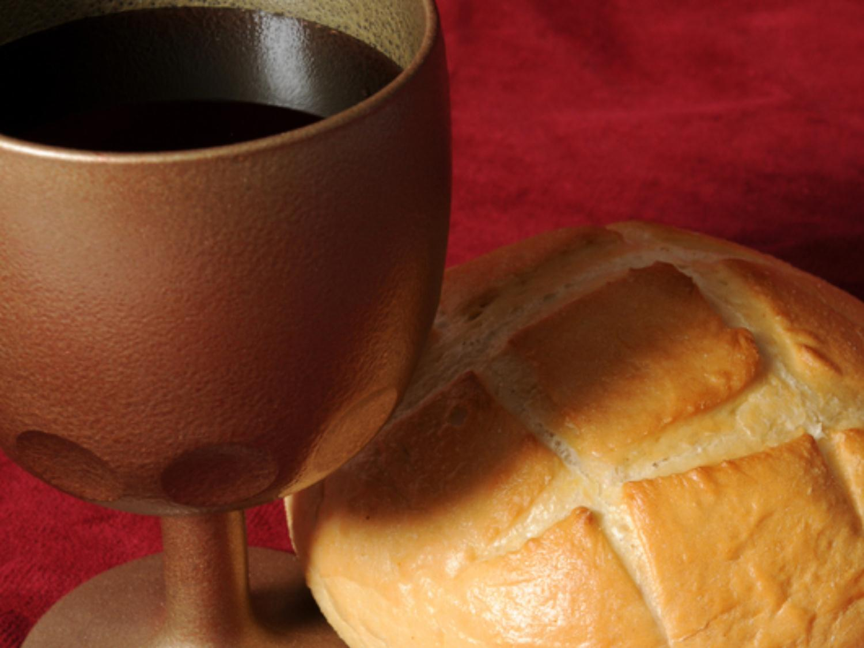
Communion

Slide 22
The Day God Left
Ezekiel 9, 10

Slide 23
Ezekiel 10:4
⁴ Then the glory of the LORD rose from above the cherubim and moved to the threshold of the temple. The cloud filled the temple, and the court was full of the radiance of the glory of the LORD.

Slide 24
Ezekiel 10:5
⁵ The sound of the wings of the cherubim could be heard as far away as the outer court, like the voice of God Almighty when he speaks.

Slide 25
Ezekiel 10:18
¹⁸ Then the glory of the LORD departed…

Slide 26
1 Kings 15:5
⁵ For David had done what was right in the eyes of the LORD and had not failed to keep any of the LORD’s commands all the days of his life—except in the case of Uriah the Hittite.

Slide 27
The Day God Left
Ezekiel 9, 10

Slide 28
Revelation 3:20
²⁰ Here I am! I stand at the door and knock. If anyone hears my voice and opens the door, I will come in and eat with him, and he with me.

Slide 29
The Day God Left
Ezekiel 9, 10

